Slide 1

6th Minor Irrigation Census Flow- MAHARASHTRA
Source: https://www.data.gov.in/
Dataset:6th Minor Irrigation Census Flow- MAHARASHTRA
linkedin:https://www.linkedin.com/in/akhila-lamba-542077293/
gmail:akhilalamba@gmail.com

Slide 2
Introduction
The 6th Minor Irrigation Census is a comprehensive survey conducted across Maharashtra to analyze the status and performance of minor irrigation schemes. These schemes play a crucial role in enhancing agricultural productivity, supporting rural livelihoods, and ensuring water resource sustainability.
This dataset consists of 99,621 records with 72 attributes, covering various aspects of minor irrigation, such as:
Scheme Type: Surface Water & Groundwater schemes
Ownership: Government, private, cooperative, and community ownership patterns
Financial Aspects: Sources of funding, construction costs, and maintenance expenses
Irrigation Coverage: Culturable command area, seasonal irrigation patterns
Scheme Status: Active, temporarily defunct, or permanently defunct schemes
Challenges & Under-utilization: Factors affecting efficiency, such as financial constraints, water scarcity, and infrastructure limitations

Slide 3
Dataset Overview:
99,621 records
72 columns
Covers minor irrigation schemes
Key aspects: scheme type, ownership, costs, financing, and utilization
Key Data Insights
High missing values in scheme status reasons, command area details
Analysis potential: scheme distribution, financing, irrigation efficiency

Slide 4
Data Preprocessing
To ensure data quality and reliability, several preprocessing steps were applied:
Handling Missing Values
Identified missing and null values in key attributes.
Used imputation techniques where possible.
Data Cleaning
Removed duplicate records.
Standardized categorical variables (e.g., ownership types, scheme status).
Data Formatting & Transformation
Converted data types (e.g., numerical to categorical, date formatting).
Normalized numerical values for analysis.
Filtering Relevant Data
Selected relevant columns for insights and removed redundant fields.
Outlier Detection
Identified and treated anomalies in financial and irrigation-related parameters.

Slide 5
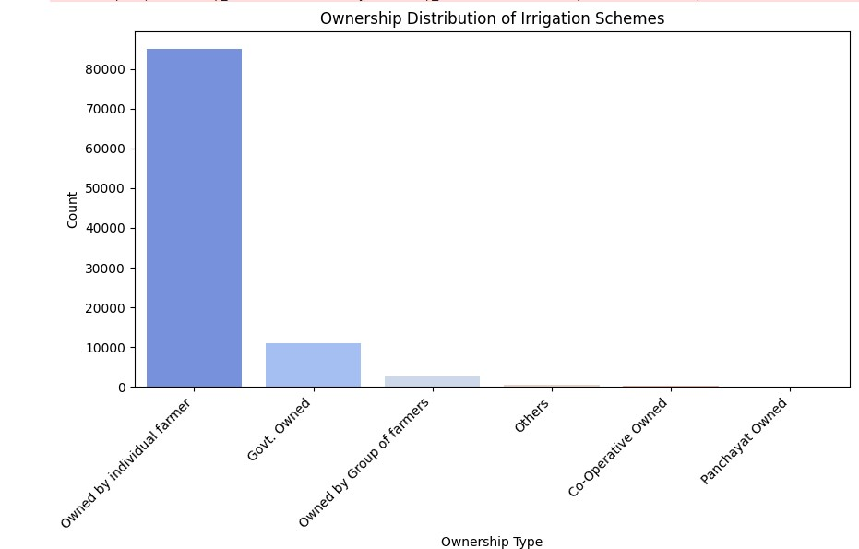
Ownership Distribution of Irrigation Schemes

Slide 6
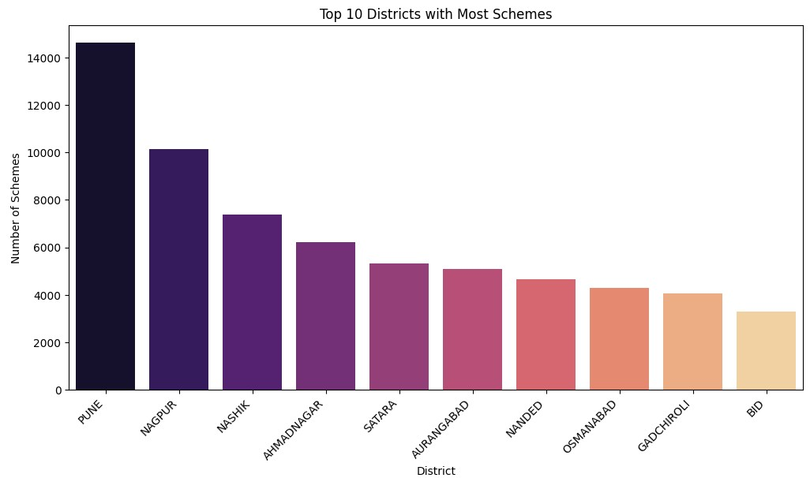
Top 10 Districts with Most Schemes

Slide 7
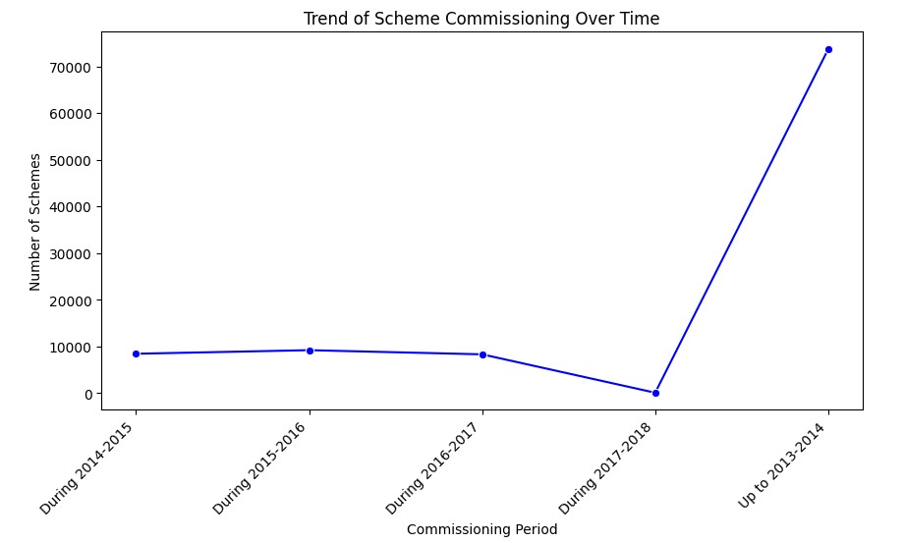
Trend of Scheme Commissioning Over Time

Slide 8
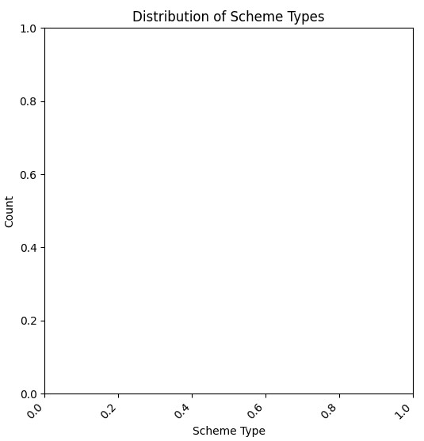
Distribution of Scheme Types

Slide 9
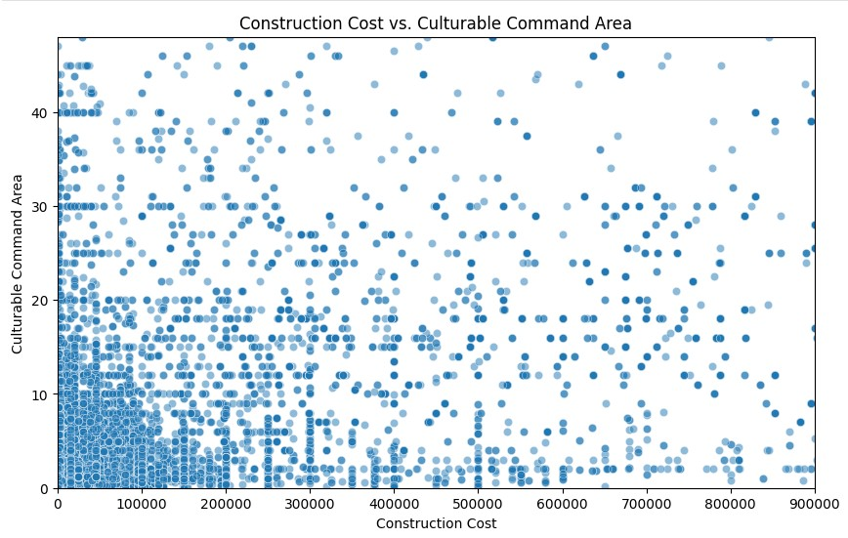
Construction Cost vs. Culturable Command Area

Slide 10
Challenges & Issues
1.Water Availability Issues
Depleting groundwater levels impacting well-based schemes.
Erratic rainfall patterns affecting surface water sources.
2.Financial Constraints
High construction and maintenance costs for schemes.
Limited government funding and subsidies, causing project delays.
3.Infrastructure Limitations
Inefficient canal networks leading to water loss.
Outdated and poorly maintained irrigation systems reducing efficiency.
4.Underutilization of Schemes
Many schemes are partially or non-functional due to poor maintenance.
.Lack of awareness and training among farmers on optimal scheme utilization.

Slide 11
Policy Recommendations
To improve the efficiency and sustainability of minor irrigation schemes in Maharashtra, the following policy recommendations are suggested:
Enhanced Financial Support
Increase government subsidies and funding for scheme development and maintenance.
Introduce low-interest loans for farmers to upgrade irrigation infrastructure.
Sustainable Water Management
Promote rainwater harvesting and groundwater recharge techniques.
Encourage micro-irrigation methods like drip and sprinkler irrigation to reduce water wastage.
Infrastructure Improvement
Modernize canal systems and pipelines to minimize water loss.
Establish real-time water monitoring using IoT-based sensors for better management.
Renewable Energy Adoption
Promote solar-powered irrigation pumps to reduce dependency on electricity and diesel.

Slide 12
Future Scope
Predictive Analytics: Using AI and machine learning to predict future irrigation trends and scheme performance.
Sustainable Irrigation Solutions: Encouraging solar-powered and rainwater harvesting-based irrigation methods.
Policy Enhancements: Strengthening government support, subsidies, and financial aid to improve irrigation efficiency.
Real-Time Monitoring: Implementing IoT-based water flow monitoring for better utilization of irrigation schemes.
Climate Resilience Strategies: Developing adaptive policies to address climate change impacts on water availability and agriculture.

Slide 13
Conclusion
The 6th Minor Irrigation Census - Maharashtra provides valuable insights into the status and performance of minor irrigation schemes across the state. Key findings from the dataset highlight:
The distribution and ownership patterns of irrigation schemes.
The financial aspects, including funding sources and operational costs.
The efficiency and utilization of these schemes, identifying underutilization causes.
Challenges such as water scarcity, infrastructure issues, and financial constraints affecting irrigation performance.
This data-driven analysis is essential for improving irrigation efficiency, optimizing resource allocation, and ensuring sustainable water management practices in Maharashtra.

